Slide 1
Clustering Cities in SHANGAI
Hemanth Sai Srinivas Kadiyala

Slide 2
1.Introduction
Shanghai is the most populous city in China as well as one of the most prosperous and modern cities in the world, is a splendid gem carved by generations of Chinese people and city planners with their remarkable wisdom. Over the past hundred years, Shanghai has thrown off shackles of pain and indignity imposed by feudalists, warlords and imperialists, and has gradually transitioned itself into the economic and financial hub in the world. Known as “Pearl of the Orient” or “Paris of the East” , Shanghai at present days has attracted millions of adventurous people from the globe to study, tour, and live in this city.
Nevertheless, for people—especially “Westerners”—who are strangers to both Shanghai and mainland China at large, starting a new life on this mysterious piece of land is difficult. For them, questions like which neighborhood to live in, basic statistics of each neighborhood, where prominent venues are located at, among others, remain unanswered.
There is a growing body of articles and blogposts on the Internet providing rudimentary city-wise information to the audience who is unfamiliar with the nuts and bolts of Shanghai. Nevertheless, they are mainly qualitative and subjective. In essence, they are not quantitatively rigorous in terms of methodology. Therefore, they run the risk of being unreliable, at least from a data analyst’s perspective. This guide, namely A Guide to Living in Shanghai, is deemed to answer the questions above and to provide an alternative, big data and machine learning-based solution to the potential trailblazers who are about to embark on a new chapter of life in Shanghai.

Slide 3
DATA
The project uses two datasets: shanghai_econ and shanghai_data.
Shanghai_econ includes economic and geographic data of all 16 districts in Shanghai. It has 6 variables: District, Population Density, Salary, Home Price, GDP and GDP Per Capita.
District is a character variable. This column lists Shanghai’s 16 districts. Population Density (person/square kilometer) is density of population in 2017 (data source: Shanghai Statistical Yearbook 2018). Salary (RMB/month) stands for personal monthly salary in 2019 (data source: Sohu). Home Price (RMB/square meter) is from the same source (Sohu). GDP (billion RMB) column has district level GDP in 2018 (data source: Sohu). Finally, GDP Per Capita (RMB) (year 2017 data) is sourced from Haojingui Finance.
Note that all data are from different sources and are in different years. This is because it is extremely hard to find one single, reliable source providing related district-level data, which turns out to be the most severe fallacy of this project. Nevertheless, it is believed that this would not affect the results too greatly given that the data usually does not change too much within 1 to 2 years if its accuracy can be fully guaranteed.
The full dataset of shanghai_econ is:

Slide 4
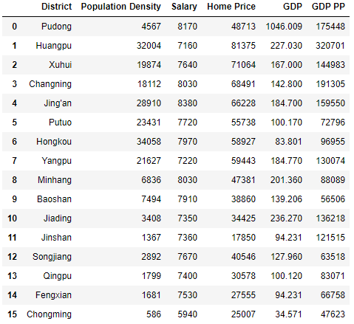
Shangai_econ district level data

Slide 5
About Shangai_data
shanghai_data lists prominent neighborhoods in Shanghai (in both English and Chinese) as well as the districts they are located in. It has three variables: District, Neighborhood and Neighborhood Chinese Name.
Honestly, “neighborhood” (社区) is essentially a “western” concept and is not used to indicate the same thing in China. In the country, a “neighborhood” is no more than a “residential community” (小区) that comprises residential buildings only rather than a spacious area that has shopping malls, stores, restaurants and attractions (and of course residential communities) in the western world. An equivalent concept in Shanghai is “subdistrict” (街道).
“Subdistrict,” however, is still not entirely the same as “neighborhood.” For instance, Wujiaochang (五角场) in Yangpu District is a subdistrict (五角场街道) in Shanghai’s township-level divisions hierarchy and can be treated as a neighborhood to an extent. In contrast, the famous Xintiandi (新天地), an area full of delicacy, decent food and fashion in Huangpu District, is not a subdistrict but can be regarded as a neighborhood.
The report adopts the western convention and focuses on a total of 47 neighborhoods (subdistricts/towns) across 16 districts in Shanghai. The author built shanghai_data based on his own discretion.
The top 10 rows of raw shanghai_data is:

Slide 6
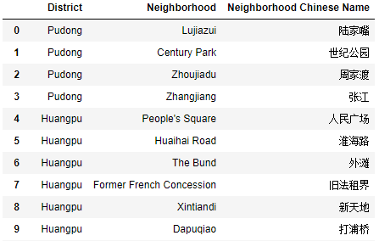
Shangai_data top 10 rows

Slide 7
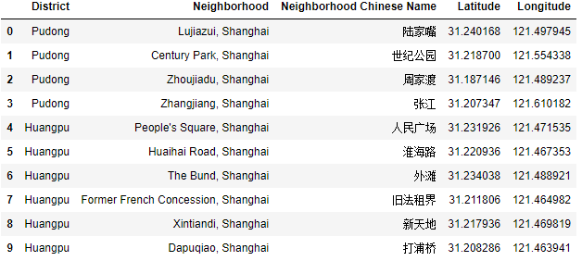
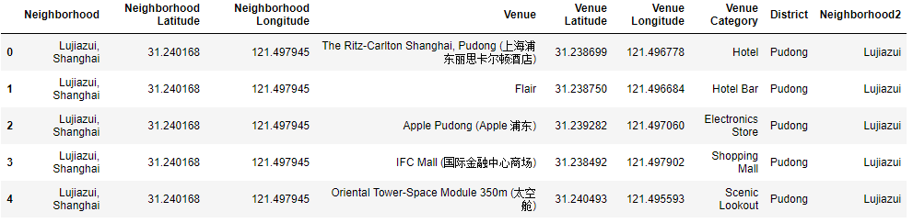
Using Geolocator we added longitude and latitude data to the dataframe
Using FourSquare api obtained venues in each city.

Slide 8
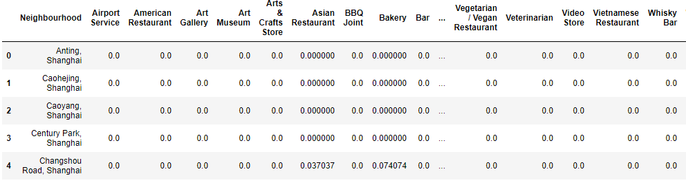
Converted data frame to categorical on basis of venue categories
This data frame is then grouped by cities with function mean

Slide 9
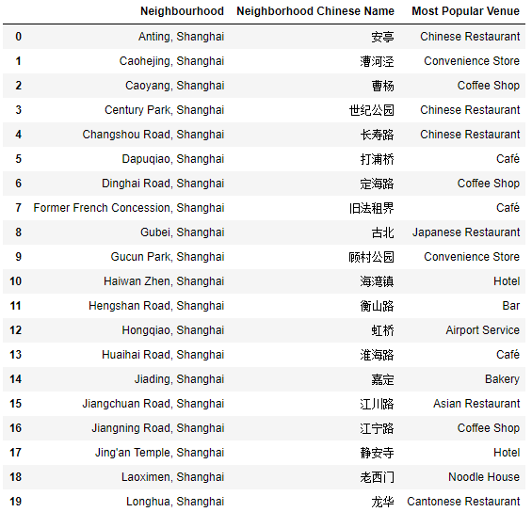
3.Modeling

Slide 10
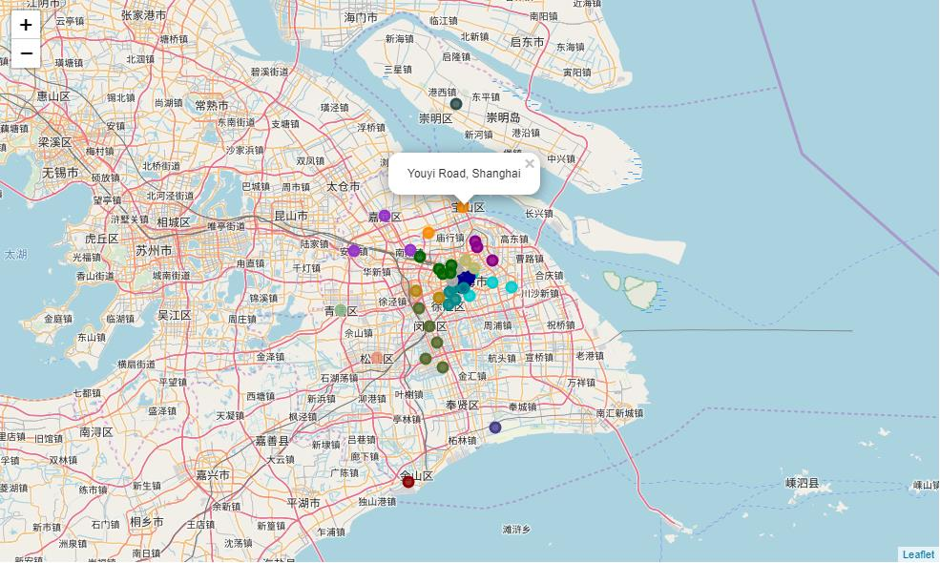
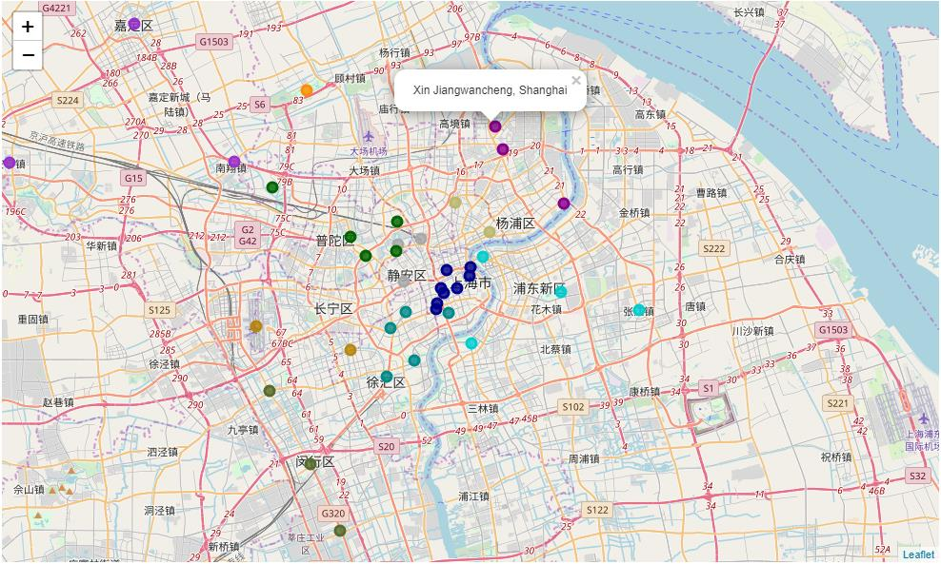
4.Visualising
Outlook of Shangai Clusters
Shangai Clusters Zoomed in

